Slide 1
TRANSPORT LAYER

Slide 2
Transport Layer
Goal
To provide reliable, cost-effective and efficient data transmission from source to destination independent of physical network(s) currently in use

Slide 3
Transport Layer Service
2 types
Connection Oriented Transport Service
Connection Less Transport Service

Slide 4
Transport Service Primitives
LISTEN
CONNECT
SEND
RECEIVE
DISCONNECT

Slide 5
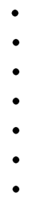
STEPS
Server
LISTEN
CONNECT
Client
CONNECTION REQ. TPDU
CONNECTION ACCEPTED TPDU
RECEIVE
TPDU
SEND
SEND
TPDU
RECEIVE
SEND
TPDU
RECEIVE
TPDU
SEND
RECEIVE
DISCONNECT
DISCONNECT TPDU

Slide 6
Elements of transport protocols

Slide 7
Elements
Addressing
Connection Establishment
Connection Release
Buffering, Flow Control
Multiplexing
Crash Recovery

Slide 8
ADDRESSING

Slide 9
Addressing 1/4
Addressing scheme is required to deliver messages from one process to another
Several processes may be running on a system at a time
To identify correct process out of the various running processes, addressing scheme (port number) is needed
Each process has a specific port number

Slide 10
Addressing 2/4
A
x
Y
1208
1522
1836
Host # 1
Host # 2

Slide 11
Addressing 3/4
Host 2 attaches to TSAP 1522 to wait for an incoming call
Host 1’s application A needs to know the time of the day, so issues CONNECT request with destination port number 1522
Connection is established
Process A sends request for time
Process X responds with current time
Transport connection is released

Slide 12
Addressing 4/4
How does process A knows about process X’s TSAP?
Schemes :
Well known port number
Initial connection protocol
Name server / Directory server

Slide 13
CONNECTION ESTABLISHMENT

Slide 14
Connection Establishment 1/3
Connection request packet
Problem – delayed duplicate
Solution – 3 way handshake mechanism
Connection confirmation packet
Data Exchange
Source
Destination

Slide 15
Connection Establishment 2/3
t1
CR
Delayed Duplicate
t10
CR
CA
DATA
t50
CR
CA
DATA
Source
Destination

Slide 16
Connection Establishment 3/3
3 way handshake
CR(seq=x)
ACK(seq=y, ack=x)
DATA(seq=x, ack=y)
Source
Destination

Slide 17
CONNECTION RELEASE

Slide 18
Connection Release 1/10
2 schemes
Symmetric Connection Release
Asymmetric Connection Release

Slide 19
Connection Release 2/10
CR
Asymmetric Connection Release
Data loss
ACK
DATA
DATA
DR
No data are delivered after a disconnect request
Host # 1
Host # 2

Slide 20
Connection Release 3/10
Symmetric Connection Release
Treats connection as 2 separate unidirectional connections to be released separately
Problem –
2 army problem

Slide 21
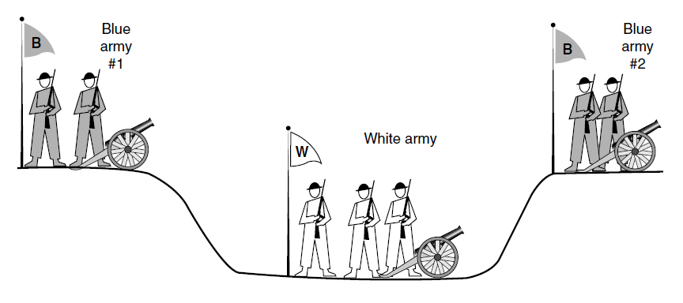
Connection Release 4/10 - Two Army Problem

Slide 22
Connection Release 5/10
Solution
Three way handshake
DR
DR
ACK
Host # 1
Host # 2

Slide 23
Connection Release 6/10-
Three way handshake
Scenarios

Slide 24
Connection Release 7/10
Scenario #1
Send DR + start timer
DR TPDU
DR TPDU
Send DR + start timer
Release Connection
Send ACK
ACK
Release Connection
Host # 1
Host # 2

Slide 25
Connection Release 8/10
Scenario #2 (Ack is lost)
Send DR + start timer
DR TPDU
DR TPDU
Send DR + start timer
Release Connection
Send ACK
ACK
lost
Release Connection
(Time out)
Host # 1
Host # 2

Slide 26
Connection Release 9/10
Scenario #3 (Response is lost)
Send DR + start timer
DR TPDU
DR TPDU
Send DR + start timer
lost
(Timeout)
Send DR + start timer
DR TPDU
DR TPDU
Send DR + start timer
Release Connection
ACK
Send ACK
Release Connection
Host # 1
Host # 2

Slide 27
Connection Release 10/10
Scenario #4 (Response is lost n times)
Send DR + start timer
DR TPDU
DR TPDU
Send DR + start timer
lost
(Timeout)
Send DR + start timer
DR TPDU
lost
(Timeout)
Release Connection
(N timeouts)
Release Connection
Host # 1
Host # 2

Slide 28
CRASH RECOVERY

Slide 29
Crash Recovery
Host
Receiver
First ACK, then Write
First Write, then ACK
Sender
Always Retransmit
Never Retransmit
Retransmit in S0
Retransmit in S1

Slide 30
